Slide 1
Single-use Quantasep Systems
First Bench-top
Single-Use flow- path Chrom System
with gradient capability

Slide 2
Quantasep 3000SU
Complete Integrated Single- Use Flow path system
Dual Peristaltic Pumps Flow Rates up to 3Lpm each
Pressure Rating 50 psi
Includes dual UV, Conductivity, pH, Air and Pressure Sensors
12 Buffer valves, 6 Fraction valves, column fwd, Rev and Bypass selection
Built in Touch screen computer and monitor with 21 CFR Pt 11 compliant software
Manual, Auto programming with event and alarm logs
Chromatogram display and
Peak /HETP analysis

Slide 3
Quantasep 3000SU Flexible Single Use Flow–path system
Change-able pump tubing enables flow rates as low as 0-400 ml/min and as high as 3LPM on each pump

Slide 4
Quantasep 3000 SU S.S Fluid Handling Module
Bench top System
Dual Pump System
Quick disconnect fittings
Easily wipe- downable
cGMP suitable

Slide 5
Quantasep 3000 SU- Easy to Use
Ergonomic Design
Touch- screen built in computer & keyboard
Easily removable front and side panels

Slide 6
Quantasep 3000 SU- Inside Look
Dual Peristaltic Pumps
Capable of Linear and Step gradients
Removable Tubing manifold
Pre Column Filter
Removable UV Flow- cell
Removable conductivity, pH, air and pressure sensors

Slide 7
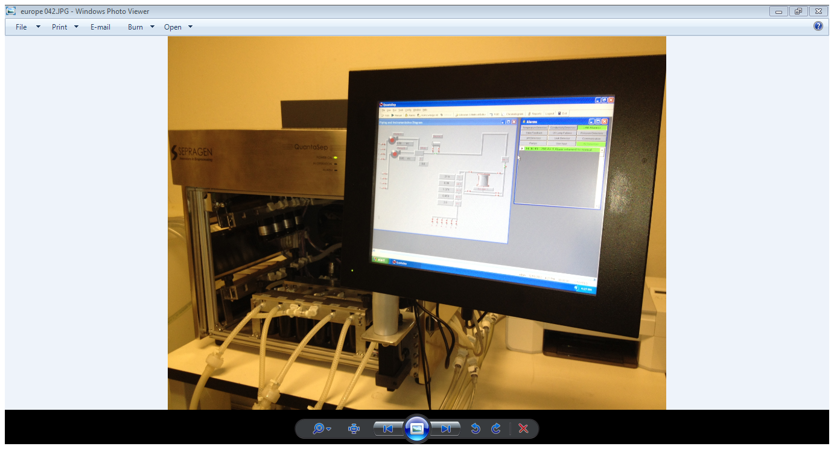
Quantasep 3000SU
Quantasep 3000 SU Software
Integrated computer control
Easy point & click interface
Auto & manual operation
Method builder and editor
Chromatogram and analysis
Event and alarm log
Easy software calibration
GMP Reports
Part 11 Compliance

Slide 8
Quantasep Software module Capabilities
Capabilities
Real time point& click process control
Data acquisition
ChromatogramAnalysis
FDA compliant Reports reports

Slide 13
Easily Removable Flow-path
Tubing Set
Pinch bar
Simply remove the Pinch- bar and remove the integrated tubing set and re- install and screw on pinch bar

Slide 14
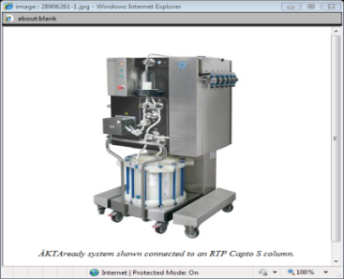
Advantages of QuantaSep 1000 SU Software vs. GE Akta Ready System
Quantasep 3000 SU vs. GE’s Akta Ready
Software Features | Sepragen | GE | Benefits
Software
Point and Click Manual Operation | Yes | No | Less training time
Online Data Analysis | Yes | No | Lower failure rate
Ease of Operation | +++ | + | Ease of Use
Ease of Programming | +++ | + | Ease of Use
Real Time Overlays | Yes | No | Improved reliability
Integrate Chrom and UF/ DF | Yes | No | 2 operations for the price of one

Slide 15
QuantaSep QSep3000 SU vs. GE Akta Ready
Hardware Features | Sepragen | GE | Sepragen Benefits
Hardware | Qsep 3000 SU | Akta Ready
Instrument Price | $105K | $155K | Greater value
Flow-path Price | $6900- $7500 | $9500 | Greater value
Pump Accuracy | +/- 3% | +/- 10% | Better performance
Typical Flow Range | 30ml/min-3000ml/min | 600ml/min-9000ml/min | Greater dynamic range
Gradient (at 50% FS) | 5-95% | No | (Optional ) Greater Applications and Buffer blending
Online Buffer Dilution | Yes | No | (Optional) Better dilution accuracy
System Volume | 200ml | ~3000 ml | Can do small samples under 10L; Better chromatography
Filtration/ Multiple Chrom Steps | Yes | No | (with multi column upgrade) Can do More
Footprint | 22”x27”x46” | 36”x48”x72” | Smaller Footprint
Auto Air Ejection | Electronic | ( NO) Bubble trap | Increased Reliability
Leak Detection | Yes | No | Increased Reliability
Up flow/ Down Flow | Yes | No | Reduced flexibility; Cannot re-use
Easy to use software | Yes | No | Easy training; usage and intervention

Slide 16
Quantasep 3000 SU Single Use Chromatography system
First Single Use bench top system
No Cleaning Validation time
Down time between batches minimized
Remove tubing path and flow cell
Easy Change –over
Low cost of system and flow-path

